Slide 1
A Presentation On Air Quality Monitoring System
Under the Guidance of
Prof. B.T.Gadade

Slide 2
1. Shubham B. Deokar
2. Rohit A. Salgar
3. Hrushikesh S. Walujkar
4. Amit M. Yele
Third Year
Mechanical Engineering
SVERI’s College of Engineering,
Pandharpur

Slide 3
Contents
1. Introduction.
2. Literature Survey.
3. Aims and Objectives.
4. Problem Statement.
5. Proposed Block Diagram.
6. Principle of Working.
7. Flow Chart.
8. Results.
9. Advantages.
10.Limitations.
11.Applications.
12.Future Scope.

Slide 4
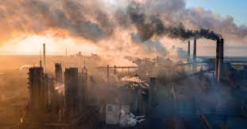
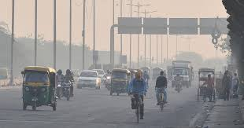
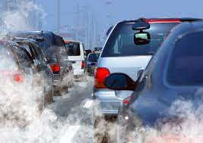
INTRODUCTION
Pollution  Traffic
Industries
Increase in vehicles
Lack of Data
Health Problems

Slide 5
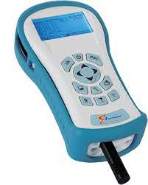
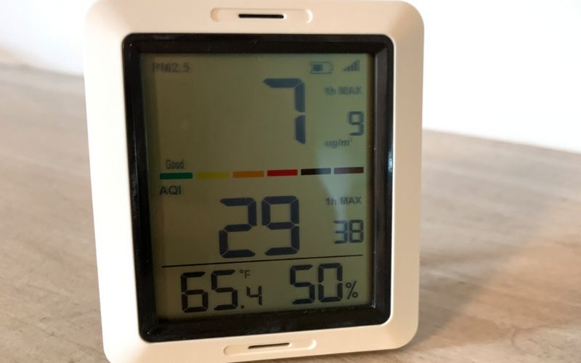
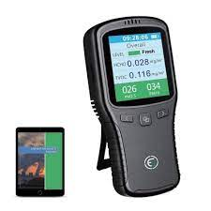
LITERATURE SURVEY
Air Quality Monitoring system at National Lab
Indoor air quality checking devices in US

Slide 6
Aim and Objectives
1> To create a tool which will monitor the quality of air of our environment.
2> Content of different gases present in air or area around us.
3> Display the data on LCD.

Slide 7
PROBLEM STATEMENT
Design a tool which will-
1)Sense quality of air and display it in the form of percentage.
2)Sense how much Carbon Mono-oxide(CO) is present in air and display in the form of percentage.
3)Sense the temperature and display it in degree celcius

Slide 8
PROPOSED BLOCK DIAGRAM
Power Supply
A
To
D
Convertor(Inbuilt ADC
Of Atmega 16)
Air Quality Sensor
MQ-135
Micro-Controller
(Atmega 16)
Display
(16+4)
CO Sensor
MQ-7
Temp
Sensor
LM-35

Slide 9
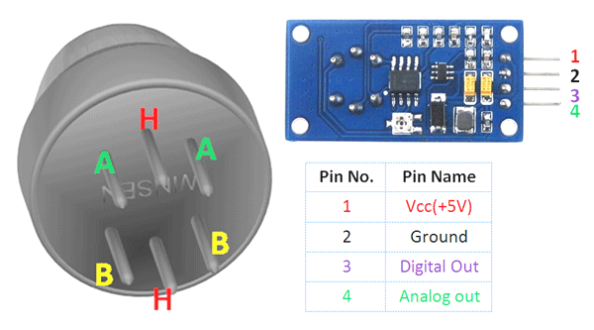
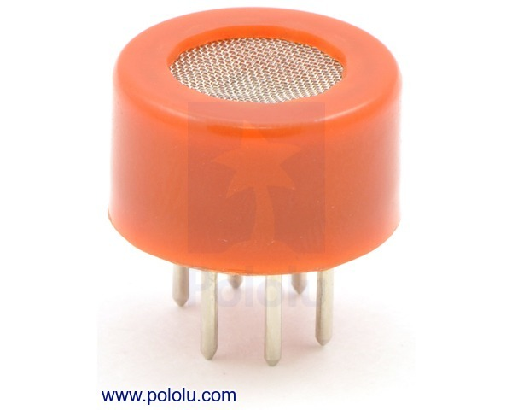
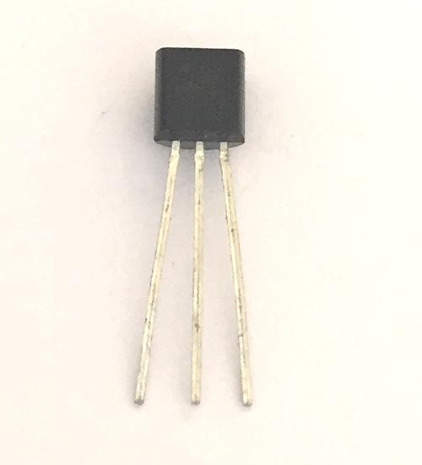
PRINCIPLE OF WORKING
Project’s basic principle of working is the sensing of data from the sensor
Convert the analog ( voltage ) data into digital form.
Process the digital data and display it on LCD. MQ 135, MQ 7, LM 35

Slide 10
FLOWCHART
Start
Turn on power Supply
Initialise LCD & Connect O/p of sensor to controller
For MQ-135
Vout < 2.0 Vout
Yes
Display
“Air Quality = 0%”
Convert Vout To Percentage And display
“Air Quality “” --- %” on LCD
B
A

Slide 11
B
A
For MQ-7
Vout < 1.5 v Volt
Yes
Display
“CO = 0%”
No
Convert Vout To Percentage and display “CO = ---%” on LCD
For LM 35 Convert Vout To “C and display “ “Temp= ---degree C” on LCD
END

Slide 12
RESULTS : MQ 135
O/p Voltage | Air Quality (%)
1.58 | 0
1.65 | 0
1.68 | 0
1.73 | 0
1.79 | 0
1.92 | 0
1.96 | 0
2.00 | 0
2.05 | 1.66
2.36 | 12
2.79 | 26.33
3.06 | 35.33
3.14 | 48
3.56 | 52
O/p Voltage | Air Quality (%)
3.84 | 61.56
3.96 | 65.33
4.10 | 70
4.26 | 75.33
4.38 | 79.33
In Case of Sensor MQ-135 If Vout<2V then 0% Pollution is present i.e<10 ppm then air is of good quality
If Air Quality is > 55% then More amount of pollution present in air. Not good for human health
As a Pollution increases then voltage is increases 1% to 55% is air having pollution between 10ppm to 16ppm

Slide 13
MQ 7
O/p Voltage | Air Quality (%)
1.78 | 0
0.85 | 0
0.96 | 0
1.05 | 0
1.17 | 0
1.43 | 0
1.65 | 4.28
1.75 | 7.142
1.86 | 10.28
1.99 | 13.61
2.16 | 18.85
2.35 | 24.28
2.55 | 30
2.76 | 36
O/p Voltage | Air Quality (%)
2.91 | 40.28
3.09 | 45.42
3.42 | 54.85
3.56 | 58.85
4.12 | 74.85
In case of Sensor MQ-7
If Vout<1.5V then 0% CO is present i.e<8ppm then air is of good air
If CO is > 36% then More amount of pollution present in air. Not good for human health.
As a CO increase then Voltage is increase 1% to 36% is air having pollution between 8 ppm to 25 ppm

Slide 14
ADVANTAGES
Sensors are easily available .
Detecting a wide range of gases, including NH3, NOx, alcohol, benzene, smoke and CO2,Co etc
Simple, compact & Easy to handle .
Sensors have long life time & less cost.
Simple Drive circuit.
System is Real time.
Operating voltage : 5 volt,-20°C to +50°C
Quality of air can be checked indoor as well as outdoor.
Visual output.
Continous update of change in percentage of quality.

Slide 15
LIMITATIONS
Only 3 sensors are used.
Humidity should be less than 95%.
Accurate measure of contaminating gases cannot be detected in ppm.

Slide 16
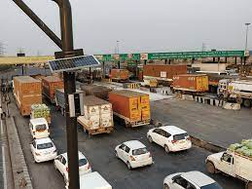
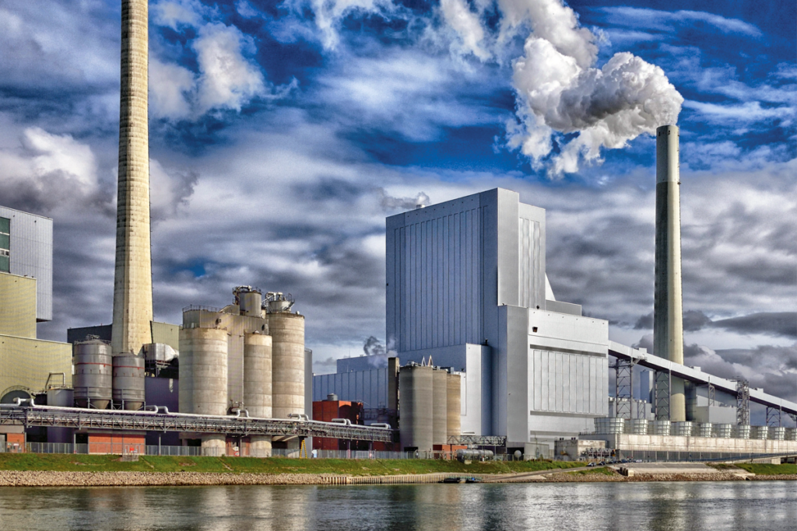
APPLICATIONS
Roadside pollution Monitoring .
Industrial Perimeter Monitoring.
Site selection for reference monitoring stations.
Indoor Air Quality Monitoring.
To make this data available to the common man.

Slide 17
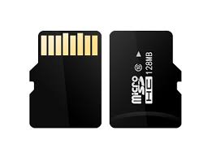

FUTURE SCOPE
In future the project can be upgraded in more ways than one.
Interface more number of sensors to know detail content of all gases present in air.
Design Webpage and upload data on webpage with date and time.
Interface SD Card to store data.
Interface GPS module to monitor the pollution at exact location and upload on the webpage for the netizens.

Slide 18
Thank You

